Slide 1


M.Tech/MCA Program
Advanced Industry Integrated Programs
Jointly offered by University and LTIMindTree
AI-Powered Healthcare System for Diabetes Risk Prediction
and Lifestyle Management
Team Member
NIVYASREE.C
Knowledge partner | Implementation partner

Slide 2
AI-Powered Healthcare System for Diabetes Risk Prediction and Lifestyle Management Management
and Lifestyle Management
Introduction
AI-based app for diabetes risk prediction and lifestyle guidance
Inputs: clinical data + meal logs via text
Uses Random Forest for risk classification and linear regression nutrition analysis
Predict risk level and Generates personalized lifestyle suggestions based on user data .
Features a user-friendly interface built with Streamlit.

Slide 3
AI-Powered Healthcare System for Diabetes Risk Prediction and Lifestyle Management Management
and Lifestyle Management
Objective
Predict diabetes risk using clinical and dietary data.
Analyze meals using NLP for calorie/sugar estimation.
Classify users into risk levels using ML.
Provide personalized lifestyle recommendations.
Build a secure, user-friendly system.

Slide 4
AI-Powered Healthcare System for Diabetes Risk Prediction and Lifestyle Management Management
and Lifestyle Management
Module name
User Authentication Module
Azure AD integration
Secure login and session management
Clinical Data Input Module
Form for entering glucose, BMI, blood pressure, age, family history
Validation and preprocessing of inputs
Meal Logging Module
Text-based box for food entries
NLP processing
Calorie and sugar estimation using Indian Nutrition Dataset

Slide 5
AI-Powered Healthcare System for Diabetes Risk Prediction and Lifestyle Management Management
and Lifestyle Management
Module name
Risk Prediction Module
ML model (e.g.,RandomForest) for diabetes risk classification
Uses clinical + nutritional data
Lifestyle Recommendation Module
Personalized suggestions based on risk level
exercise, and follow-up advice
Frontend UI Module
Built with Streamlit
Interactive dashboards and input forms

Slide 6
AI-Powered Healthcare System for Diabetes Risk Prediction and Lifestyle Management Management
and Lifestyle Management
Methodology/Modeling Plan
Core Feature 1: Diabetes Risk Prediction
Model Used: Random Forest Classifier.
User Input: Clinical data such as blood glucose level, BMI, blood pressure, and age.
Output: Classifies the user's diabetes risk into "Low," "Moderate," or "High.“
.

Slide 7
AI-Powered Healthcare System for Diabetes Risk Prediction and Lifestyle Management Management
and Lifestyle Management
Methodology/Modeling Plan
Core Feature 2: Nutrition Analysis
Models Used: Two Linear Regression models.
User Input: A text-based list of meals consumed.
Technique: Uses TF-IDF (Term Frequency-Inverse Document Frequency) to convert meal descriptions into numerical features.
Output: Estimates total calorie and sugar intake from the logged meals.

Slide 8
AI-Powered Healthcare System for Diabetes Risk Prediction and Lifestyle Management Management
and Lifestyle Management
Methodology/Modeling Plan
Application & Technology
Frontend: Built with Streamlit for an interactive and user-friendly web interface.
Integration: The trained machine learning models are loaded into the application to process user data in real-time.
Final Output: Generates a personalized action plan with tailored dietary, lifestyle, and medical suggestions based on the combined AI-driven analysis

Slide 9
AI-Powered Healthcare System for Diabetes Risk Prediction and Lifestyle Management Management
and Lifestyle Management
Methodology/Modeling Plan
Diabetes Risk Prediction (Classification):
A Random Forest classification model is trained on a clinical dataset.
It uses key features like blood glucose, BMI, and age to classify users into "High," "Moderate," or "Low" diabetes risk categories.
Nutrition Analysis (Regression):
Two Linear Regression models are trained on a food nutrition dataset to estimate calorie and sugar content from text.
It uses TF-IDF (Term Frequency-Inverse Document Frequency) to convert user-inputted meal descriptions into numerical features for prediction.

Slide 10
AI-Powered Healthcare System for Diabetes Risk Prediction and Lifestyle Management Management
and Lifestyle Management
Data preprocessing & EDA
Diabetes Dataset (Clinical Data)
Preprocessing:
Imputed missing values using the median.
Encoded text categories (gender, smoking) into numbers.
Scaled numerical features for the model.
EDA Insights:
Identified significant class imbalance in the target variable.
Found strong correlations between diabetes and blood_glucose/HbA1c levels via a heatmap.

Slide 11
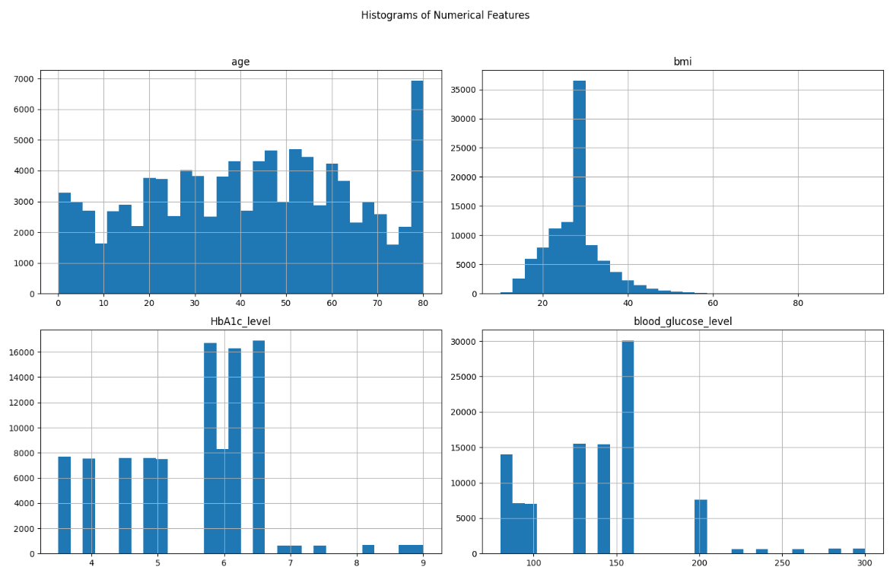
AI-Powered Healthcare System for Diabetes Risk Prediction and Lifestyle Management Management
and Lifestyle Management
Data preprocessing & EDA

Slide 12
AI-Powered Healthcare System for Diabetes Risk Prediction and Lifestyle Management Management
and Lifestyle Management
Data preprocessing & EDA
Nutrition Dataset (Food Data)
Preprocessing:
Cleaned and imputed missing calorie/sugar values.
Converted text (Dish Name) into numerical vectors using TF-IDF.
EDA Insights:
Analyzed the relationship between text features and nutritional values to confirm model feasibility.

Slide 13
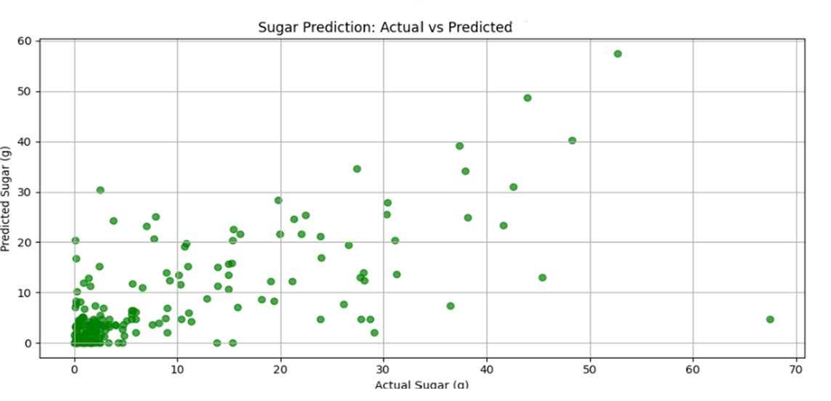
AI-Powered Healthcare System for Diabetes Risk Prediction and Lifestyle Management Management
and Lifestyle Management
Data preprocessing & EDA

Slide 14
AI-Powered Healthcare System for Diabetes Risk Prediction and Lifestyle management Management
Approach/Algorithms/Tools…. Calibri body -36
Approach
Dual-Model System: Two separate machine learning pipelines for diabetes and nutrition.
Classification: Predicts diabetes risk level (Low, Moderate, High).
Regression: Estimates calories and sugar from text-based meal descriptions.
Integration: Deploys models in a Streamlit app for real-time user feedback.

Slide 15
AI-Powered Healthcare System for Diabetes Risk Prediction and Lifestyle Management
Approach/Algorithms/Tools
Algorithms
Diabetes Risk Prediction:
Random Forest Classifier: For high accuracy in risk classification.
GridSearchCV: To tune and optimize the model.
Nutrition Analysis:
TF-IDF Vectorizer: Converts meal text into numerical features.
Linear Regression: Predicts calorie and sugar values

Slide 16
AI-Powered Healthcare System for Diabetes Risk Prediction and Lifestyle management Management
Approach/Algorithms/Tools…. Calibri body -36
Tools & Libraries
Frontend & UI: Streamlit
Data Manipulation: Pandas, NumPy
Machine Learning: Scikit-learn
Data Visualization: Matplotlib, Seaborn, Plotly
Model Persistence: Joblib

Slide 17
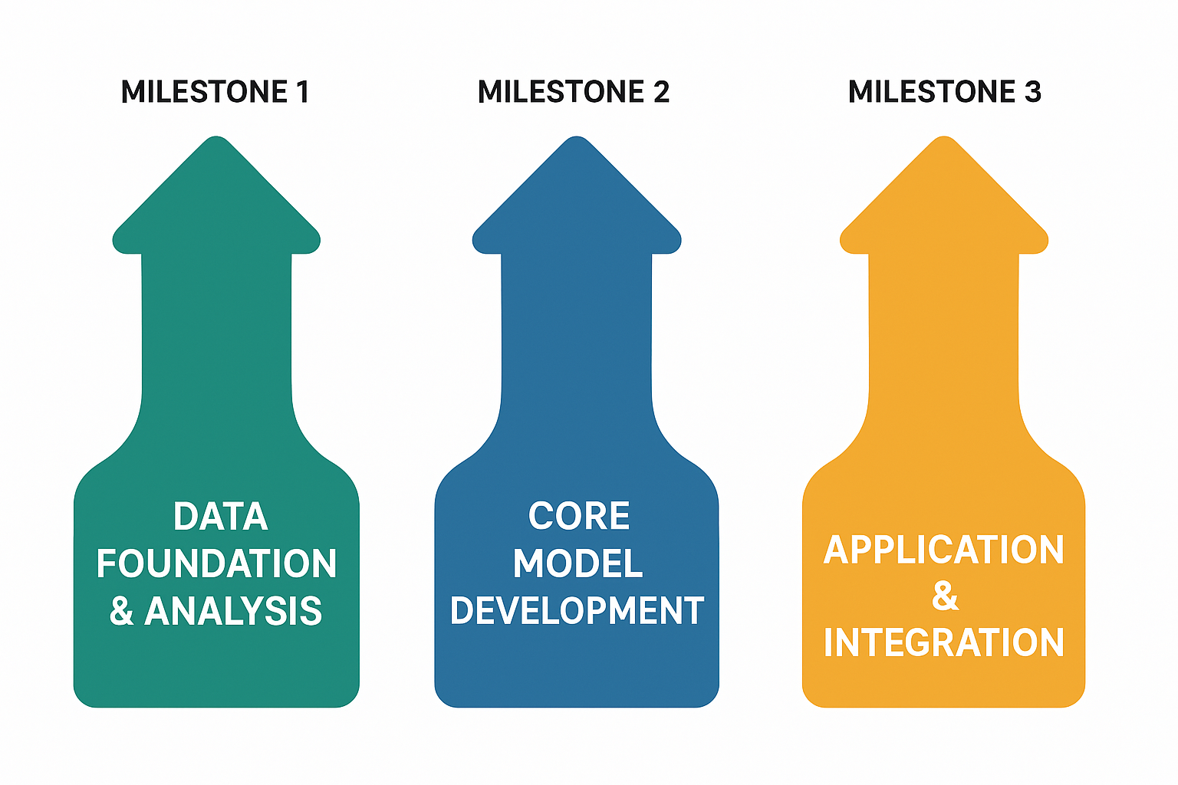
AI-Powered Healthcare System for Diabetes Risk Prediction and Lifestyle management Management
Project plan/milestones progress

Slide 18
AI-Powered Healthcare System for Diabetes Risk Prediction and Lifestyle management Management
THANK YOU

